Slide 1
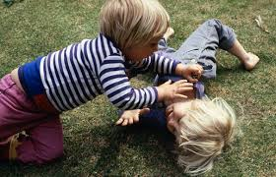
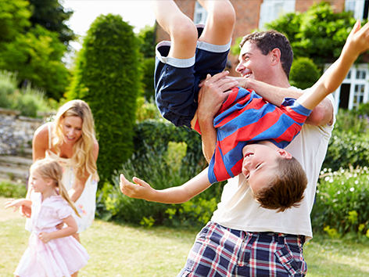
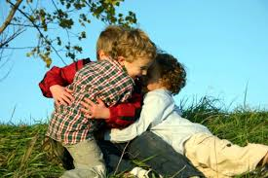
Short introduction in Resilience through resistance
Pauline Fellinger
PMT Teacher / judotrainer Windesheim, Netherlands

Slide 2
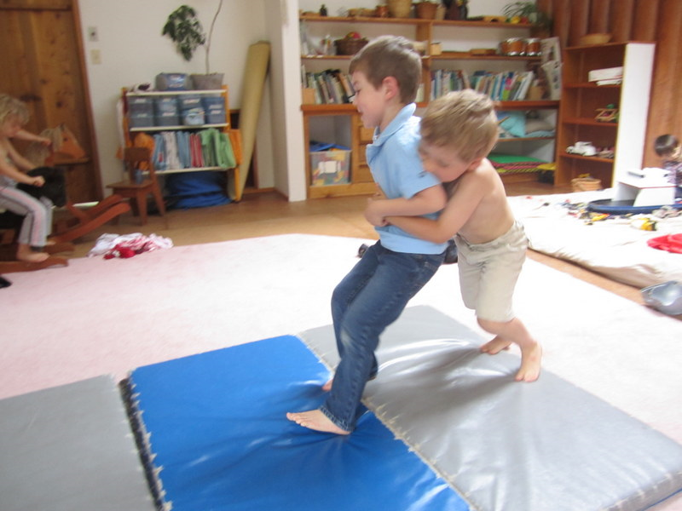
Let’s take a look first…
https://drive.google.com/file/d/0B8ZfpZuCqdDJRVZhd0pfU00yTkE/view?usp=sharing

Slide 3
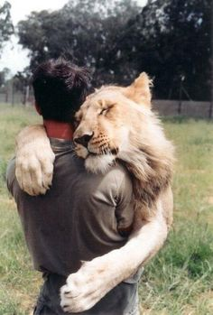
What did you saw ?
Children
On a judo mat
In a judo jacket
Playing tough and rumble play…
(judo-like)
With fun and motivation… ☺

Slide 4
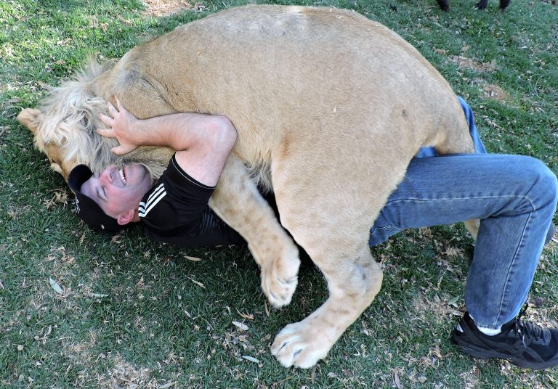
What was behind ?
Children from a school of special needs
With problems in resilience and motivation
Hidden in their jackets
Feeling stronger on the mat
Trying to set / use their own power
In the context of a social accepted sport

Slide 5
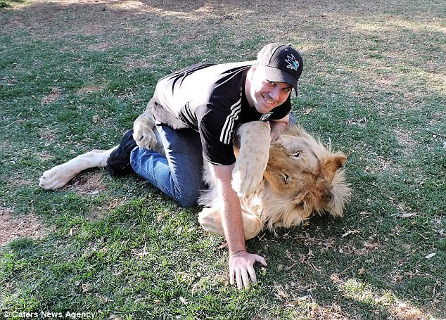
Why we work this way ?
Rough and tumble play or judo can improve the resilience of people
https://pgpedia.com/r/rough-and-tumble-play
The play form does not refer to therapy, but to sport or free time = low threshold
Therefor we prefer the name of Judo
This playform / sport also contains a high amount of possible goals next to resilience :
body awareness – coordination – high and low positions – all are equal in the jacket
Notes:
The advantage of the name Judo = for the children that they have the feeling that they are, as normal kids in a sport club. In stead of; having therapy, special needs lesson, counseling…

Slide 6
What is resilience ? (1)
Resilience is the ability of a
system to cope with change
Psychological resilience is an individual's ability to successfully adapt to life tasks

Slide 7
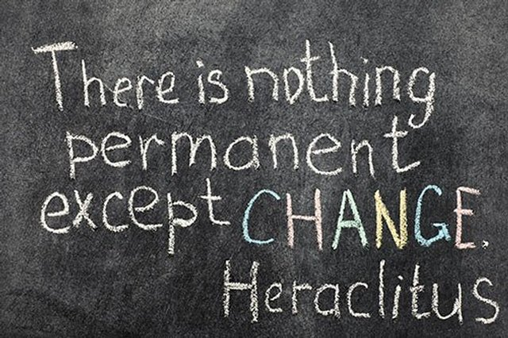

Slide 8
In judo: change is everywhere + anytime:
- You are up, you are down,
- You win, you loose,
- You feel no power, you use power of the other
But in a very orginized, controlled way
- There is a start and a stop
- There are rules to follow
- There is a strict order and place

Slide 9
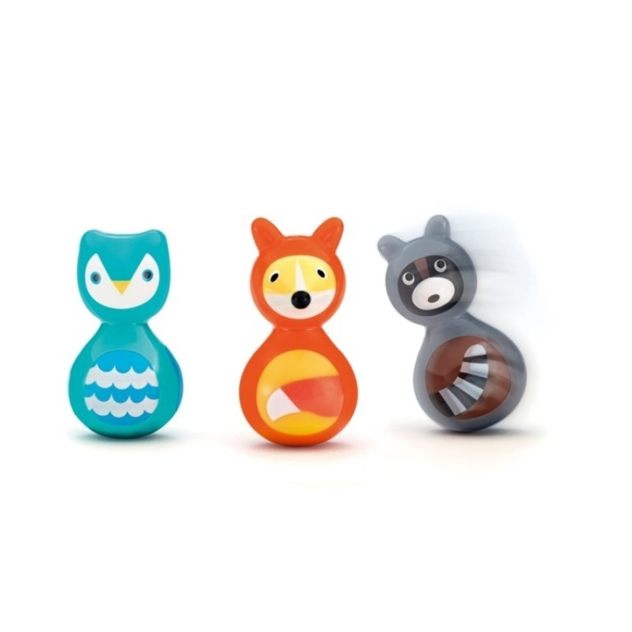
What is resilience ? (2)
Resilience is one's ability to bounce back from a negative experience with "competent functioning".
In Judo (or rough &tumble play): you can literaly bounce back: thrown on the ground, you can use the movement to come above or to take over the initiative and turn your chances
Notes:
movement (strenght / power of the other)

Slide 10
What is resilience ? (3)
Not true: resilient people are free from negative emotions or thoughts, and remain optimistic in all situations.
True: resilient people
have, through time, developed
proper coping techniques
The coping technics and structure in judo are symbolic and helpful for the psychological coping technics

Slide 11
Let’s see in detail…
Studies show that there are several factors which develop and sustain a person's resilience:
Fredrickson, B. L.; Branigan, C (2005). "Positive emotions broaden the scope of attention and thought-action repertoires". Cognition & Emotion. 19 (3): 313–332.
The ability to make realistic plans and being capable of taking the steps necessary to follow
A positive self-concept and confidence in one’s strengths and abilities
3. Communication and problem-solving skills
The ability to manage strong impulses and feelings

Slide 12
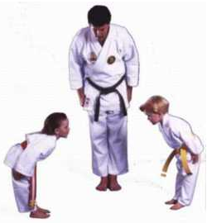
1. The ability to make realistic plans
The structure of judo is functioning as a (external) plan
Ritual of greeting on a fest spot,
Sign to begin (hajimé)
Each play for a short time
tapping = stop
Winning grip = max. 10 sec.
Sign to stop (maté)
Notes:
Voorbeelden van spelletjes

Slide 13
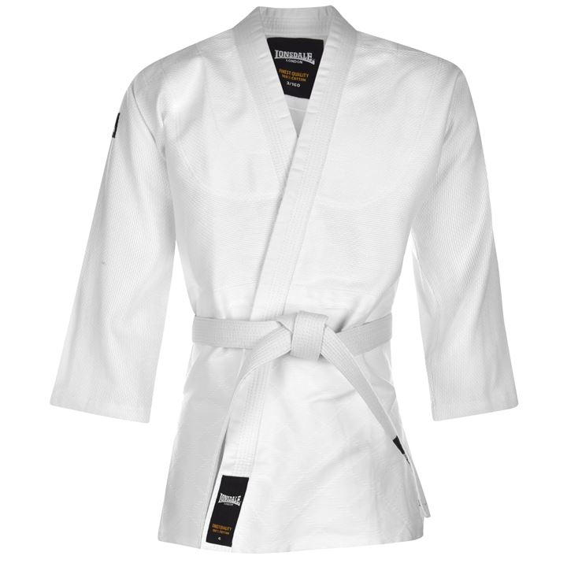
2. A positive self-concept
Judo can always leads to a (arranged) positive experience
The jacket = save feeling = self-confidence
The judoband = visual sign of reached succes
Different starting positions =
chance for everyone
Positions on the ground =
everyone equal and low
Added factor of luck = succes always
possible

Slide 14
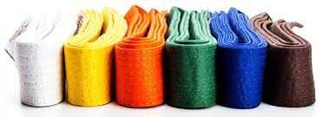
3. Communication skills
Judo has his own fixed communication (‘habits’)
Tapping = stop
Grip on the head = forbidden
After 10 sec. you have to loosen your grip
A higher colorband = careful with
a lower colorband
5. After winning, you give space

Slide 15
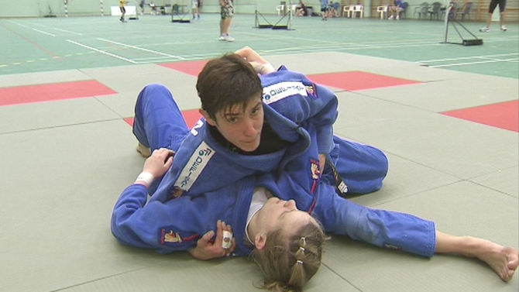
4. The ability to manage strong impulses
Judo can contain negative impulses by:
Variation in playform with more or less space
Using the commands of hajimé and maté
Possibility in using the playground
or the resting-place
Choise in (power of) partner
5. Choise how many partners
6. Difference in roles
Notes:
Less space is sometimes containing the judoka

Slide 16
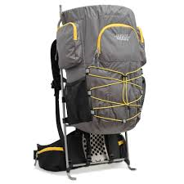
transfer
Although Judo offers an external frame of coping technics…
… after a while, due to S-R conditioning
it will become an internal frame with a lot of
useful bagage for resilience…

Slide 17
Why specially with autistic children ?
See Judo Zwolle (movie SIO)
ASS children have low resilience
ASS children needs/likes stucture
ASS children needs/likes the concrete rules and rituals Judo can offer
ASS children likes the jacket as ‘body – protection’
ASS children likes the benefits written before
Judo gives boundaries, etc.

Slide 18
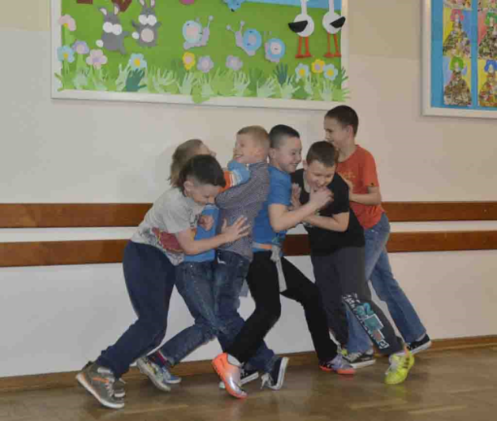
Difference Judo and Rough and Tumble Play ?
What’s in a name….
judo = official sport, rough and tumble = natural and free play
We use rough and tumble play within Judo
We don’t only focus on the official side of Judo
We introduce ‘new technics’ and natural exersises
Children with ASS like to say: “I am doing judo as a sport…”
For all official partners we call it what is tactical the best → it can create ‘money’
Notes:
On a normal school we call it rough and tumble play, on a special school: Judo, in parent counseling and social work: rough and tumble play, in Rehabilitation: Judo, in Youth Health: Rough and tumble play

Slide 19
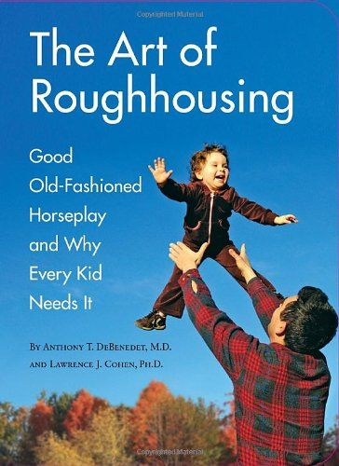
The idea of this play form is hot…

Slide 20
Why so hot ?

Slide 21
… more benefits …

Slide 22
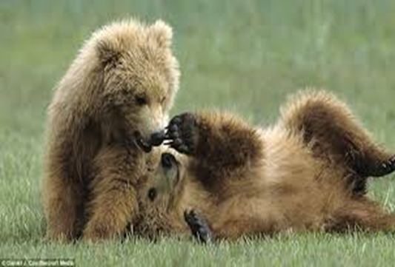
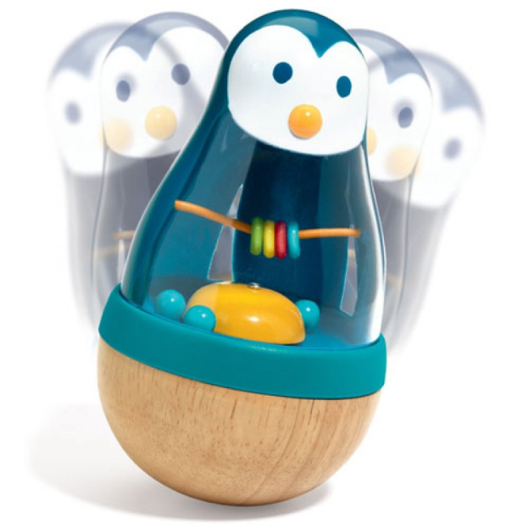
Quality of life grows with resilience
So we want for all people,
you and me
with / without ASS
Judo or Rough & Tumble play.
To gain the ability to
bounce back and handle
all changes in life

Slide 23
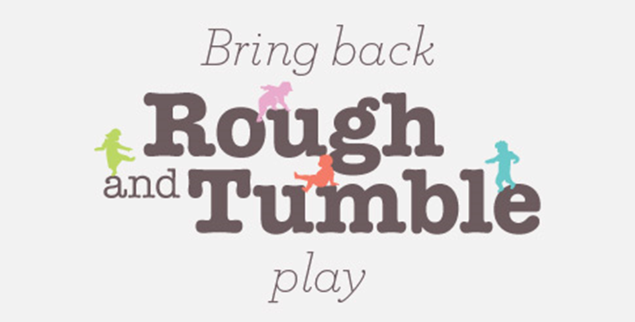
Therefor…
So let’s play with us Judo now
for more resilience in you ☺

Slide 24
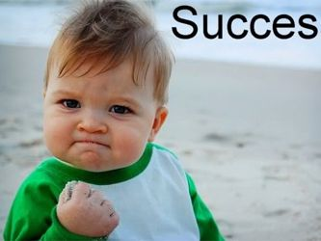
Take of your shoes, put on your jackets !

Slide 25
Tak Thanks Merci Danke Dank Obrigado !!
More information:
Pauline Fellinger info@praktijkfellinger.nl
+31 – 6 16 53 78 79
prg.fellinger@windesheim.nl
+31 – 88 46 99 111

