Slide 1
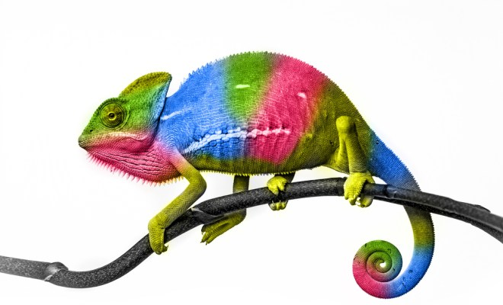
A D A P T I N G W I T H I N R E S I L I E N CE

Slide 2
F I G H T I N G • M O N K E Y
Write down three words on your experience
Save them for later
Notes:
The exercise described:
Pair up
Choose an A and B
A places him/her hands on top of B’s hands. B starts with leading and A should follow A’s movements. Play with levels, speed and size of the movement.
When your partner is ready you can start challange him/her more.
Switch so A is now leading.
Now the leader can now slap the followers hands. The follower therefor has to concentrate on following and watching out.
Switch.
Now the leader can ALSO step on the followers toes. So the follower now has three elements to be aware of.
Switch.
The end.

Slide 3
A • D E F I N I T I O N
”Resilience is the ability of a system to cope with change”
”Psychological resilience is an individual’s ability to succesfully adapt to life tasks.”
“Resilience should be considered a process; rather than a trait to be had. It is a process of individuation through a structured system with gradual discovery of personal and unique abilities” (Rutter, M 2008) “Developing concepts in developmental psychopathology”, pp. 3-22 in J.J Hudziak (ed.)
Notes:
Occupational safety in heath (OSH): https://www.ncbi.nlm.nih.gov/pmc/articles/PMC4867880/#!po=19.0265

Slide 4
O U R • W E E K
Two point of views
Limitation vs. All-in
Finding balance
“Adapting” was the link

Slide 5
T H E • T H E O R Y
Internal assets
Self-awareness
Empathy
Communication
Cooperation
Problem-solving
Self-efficasy
External assets
Family
Friends
Education
Economy
Professional help
Notes:
Summer School litterature for ”Resilience in PMT” – ”A Resilience Curriculum for Early Years and Primary Schools in Europe: Enhancing Quality Education”.

Slide 6
A N O T H E R • E X E R C I S E
Round 1 – Move freely to music
Round 2 – Choose a ”disabilty” to move with
Notes:
Describtion of exercise: 1 Round: everybody move to music freely – you can use balls or scarfs which is placed in the room. 2. Round: everybody have to choose a body part which ”doesn’t work”/a disability like a broken leg and then everybody have to move with their disability. Afterwards we talk about the feelings you had when you had to move with a disability.

Slide 7
T H E • E N D
Write down three words on your experience
What ressources did you use to adapt?
Was it internal or external?

