Slide 1
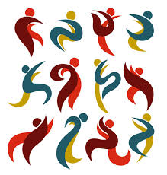
Motricidade
SS 2016 Zwolle
Daniela Vieira
Gonçalo Azevedo
Joana Pereira
Margarida Santos
Portugal – FMH

Slide 2
Introduction
The theory of the “human psychomotor system” (SPMH).
Luria’s Theory and SPMH.
The seven psychomotor factors.
What are the consequences of a poor psychomotor development?
How to manage stress?
Dance movement therapy.
Activities.
Conclusion.

Slide 3
The theory of the “human psychomotor system” (SPMH)
Motricidade is common in every vertebrate animals. Due to the environment and the connection with the human species, the neuroanatomy of the brain (lobes) became more specific and complex.
Therefore… Psychomotricity appear as something exclusive and special in the human being.
(Fonseca, 1994)

Slide 4
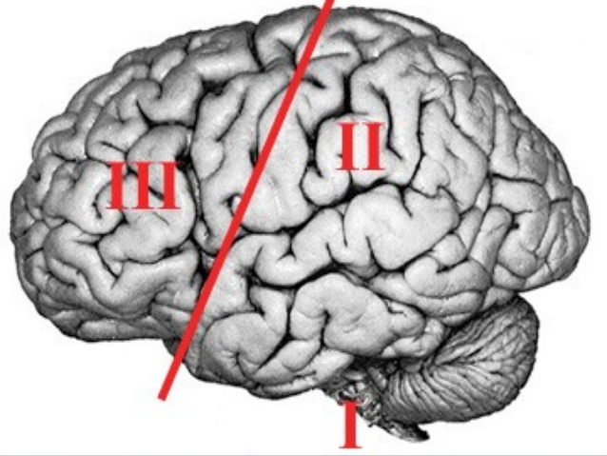
Luria’s theory of brain functioning and SPMH
According to Luria (1975), the brain is divided in three parts:
1st – attention, vigilance, sensorial integration;
2nd – analysis, synthesis, information storage and senses association;
3rd – planning, programing and regulation of the motor act.
(Fonseca, 1994)

Slide 5
The seven psychomotor factors
Fine praxis
Global praxis
Body awareness
Space and time structure
Lateralization
Balance
Tonicity
(Fonseca, 1994)

Slide 6
What are the consequences of a poor psychomotor development?
According to Fonseca (1994), a poor psychomotor development can lead to learning and motor difficulties (e.g. problems in graphomotricity).
Children with motor difficulties
Low performance
Criticized by the peers
Increased stress and anxiety
(Schoemaker & Kalverboer, 1994)

Slide 7
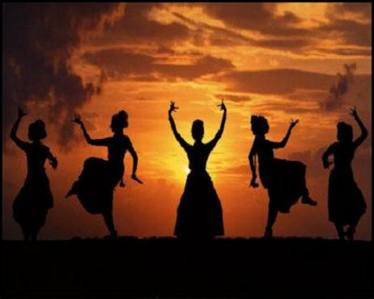
How to manage stress?
Dance Movement Therapy
Creative body-oriented psychotherapy (movement, dance, verbal interaction)
Emotional, cognitive, physical and social integration of the individual
Brauninger (2012)

Slide 8
Dance movement therapy
Stress management improvement
Stress reduction
Interpersonal sensivity
Distress reduction
Awareness
(senses, feelings, images, thougths, cognition)
Relaxation
Brauninger (2012)

Slide 9
Activities
Activity A:
Level 1 – standing in a circle, each person has to pass a ball (for instance, red) to the person in the right. When the therapist claps once, the way the ball goes has to change.
Level 2 – adding a second ball (for instance, green) they have to do the same by passing each ball in tthe oposite way.
Level 3 – (continuation) and when the therapist claps twice, all the participants have to march at the same place
(note: the activities will variate according to the group characteristics)

Slide 10
Activities
Activity B:
Listening to a music chosen by the therapist, each person starts to move their body parts, according to the orientation of the therapist (for instance, arms first, then the head...)
The participants have to try to be in the flow of their feelings and be aware of their body sensations.

Slide 11
Conclusion
Psychomotor factors can be a point of reflection in all the workshops we have done;
Psychomotor development influences the body awareness and all that is experienced throughout our lives;
The way you experience your body will make you understand yourself, others and the environment.

Slide 12
References
Brauninger, I. (2012). Dance movement therapy group intervention in stress treatment: A randomized controlled trial. In: The Arts in Psychotherapy, nº 39, pp. 443-450.
Fonseca, V. (1994). Psicomotricidade e Psiconeurologia: Introdução ao Sistema Psicomotor Humano. In Revista Neuropsiquiatria da Infância e da Adolescência vol. 2, nº 3, pp. 23-33.
Schoemaker, M., Kalverboer, A. (1994). Social and Affective Problems of Children Who Are Clumsy: How Early Do They Begin? In: Adapted Physical Activity Quarterly, vol 11 (2), pp. 130-140

