Slide 1
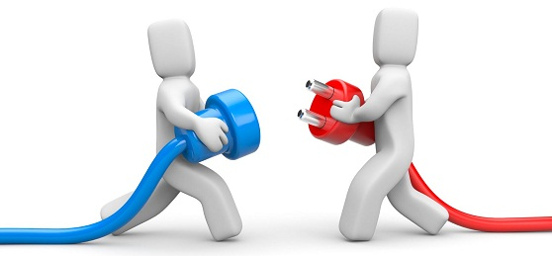
Move to be …
Connected
Riemke Ruitenbeek
Sander poot Nora gerritsen

Slide 2
What did we learn this week?

Slide 3
A lot!
The body and being connected/disconnected and how to re-connect.
Different ways of connecting (with yourself/your body/space/others).
Different ways of using the body (to guide/assist, to level with cliënts/making contact, feeling one with your body/mind.
The body as our instrument.
The body and our movements as answers for our feelings.
We also learned a lot from the studends/other countries, they really inspired us with their knowledge and state of being. Personal talk about what was the most special memmory of the week:

Slide 4
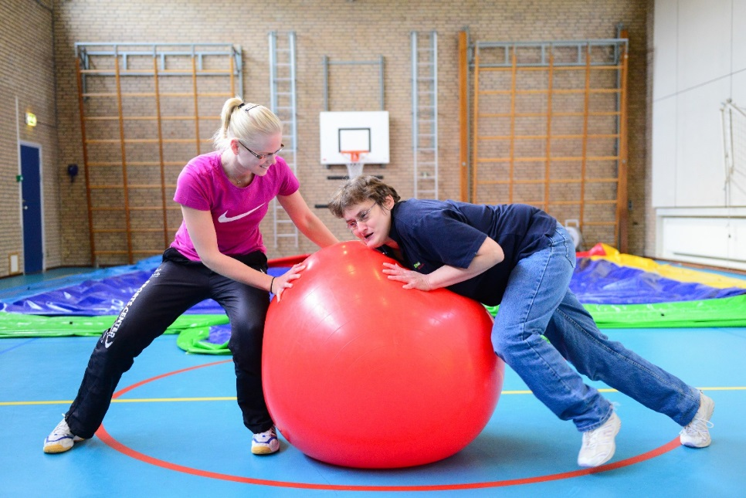
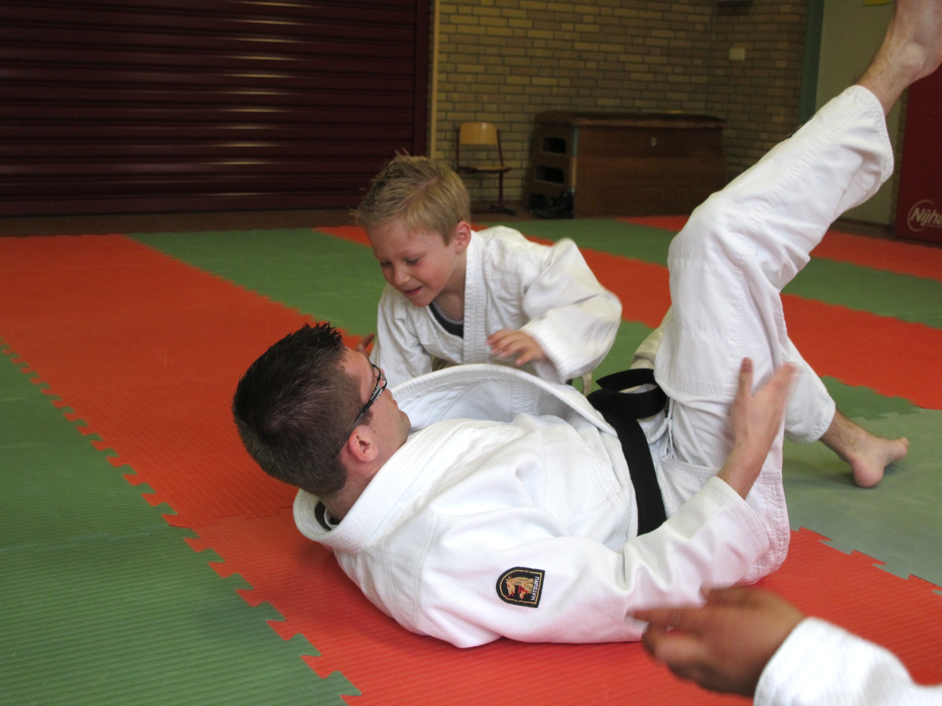
Let’s start with a typical dutch exercise we use in psychomotor therapy

Slide 5
Bal afpakkertje “steal the ball” Rough and tumble play
Two people(A&B) are sitting on one mat and have one ball. A is going to try to steal the ball from B (1 min)
Switch!
Main rule: Stop = stop!

Slide 6
Reflection/discussion
How was it for the protecters of the ball? - Were you competitive? - What was your technique/stragety? - Were you connected/disconnected? On what way? With the ball, yourself/awareness of the body, the other person? - What was your overal feeling?
And for the attackers/grabbers? - Were you competitive? - What was your technique/stragety? - How were you connected/disconnected and on what way? - What was your feeling when you got the ball/ or not?
What theme’s are you thinking of?
With what kind of people would this kind of exercise work?

Slide 7
Theory
The biopsychosocial model is aimed on the psychologic and social levels beside the biological effects to come closer to reality than just the biomedical model (George & Engel, 1980).

Slide 8
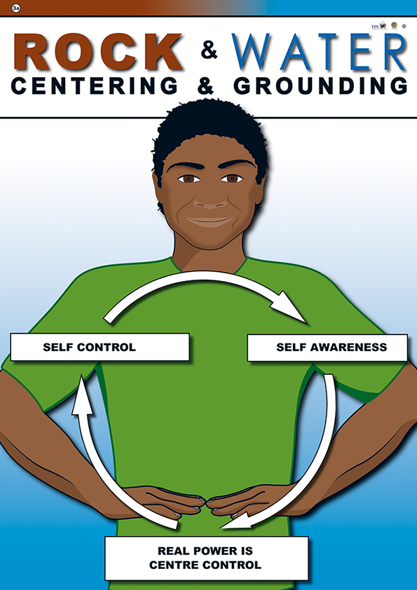
Typical dutch: Rough & tumble play in psychomotor therapy Rock&Water
R&T are used in a playfull way. (play wrestling and play chasing). The behavioral components of R&T are typically playful and nonaggressive (Blurton Jones, 1972)
The Rock and Water program is developed by Dutch educationalist Freerk Ykema. The program aims improving the social, emotional and spiritual development of the human being. raising self-awareness of personal strengths and abilities (Brenton, Cenuich & Raymond, 2009) the three foundations skills of Rock and Water: self-control, self reflection and self confidence For more information go to www.rockandwaterprogram.com

Slide 9
Research showed that RTP can be associated with behavior problems when fathers don’t have an authoritative positions in the play interactions (Flanders et al, 2009)
Relation between RTP/Rock&Water and BPS

Slide 10
Intervention on the exercise
We made an intervention (in the exercise) on what we learned this week
It’s new for us to, so we can all experience!
Group A protects the ball. Now take a minute and try to anker something to the ball that is important/close to you. It can be anything you want: family/friends/hobby/memmory.
Group B wants to take over the ball Observe the other person, how do you feel to respond? (attunement)

Slide 11
Reflection/Discussion
Group A (protecters)
How was the connection now?
What happened in the body? Was there a difference with the first time? - Weight, grounding, attitude, space/movement etc…
How was the attunement/connection with the other person?
Group B
How was it to take something important from the other person?
How did you respond on the other person?
In Holland we use context manipulation. With a rationale/mental set you can combine an exercise to a theme/setting/goal you want to trigger. What themes fits with this exercise? Time left? Switch rolls and see if there is a difference after the discussion! You can see, with an intervention the same exercise can become a different theme, our aims a different part of the theme. The feeling is different, your thoughts are different. Maybe the first time it felt like a game, and the second part not?

Slide 12
Questions?

Slide 13
Source
Blurton Jones, N. (1972). Categories of child child interaction. In N. Blurton Jones (Ed.). Ethological studies of child behavior. (pp. 97-129). London: Cambridge University Press.
George, L. & Engel, M. D. (1980) The Clinical Application of the Biopsychosocial Model. THE AMERICAN JOURNAL OF PSYCHIATRY. 13(5), 535-544.
Brenton, T., Cenuich, A. & Raymond,I (2009) Elizabeth Vale Rock & Water Program: Program overview and Qualitative Evaluation. Retrieved from: http://rotsenwater.nl/download/evaluations/eng/rock_and_water_program_evaluation_elizabeth_vale-1.pdf
Pellegrini, A. D. & Perlmutter, J. C.(1988) The Diagnostic and Therapeutic Roles of Children’s Rough-and-Tumble Play.

Slide 14
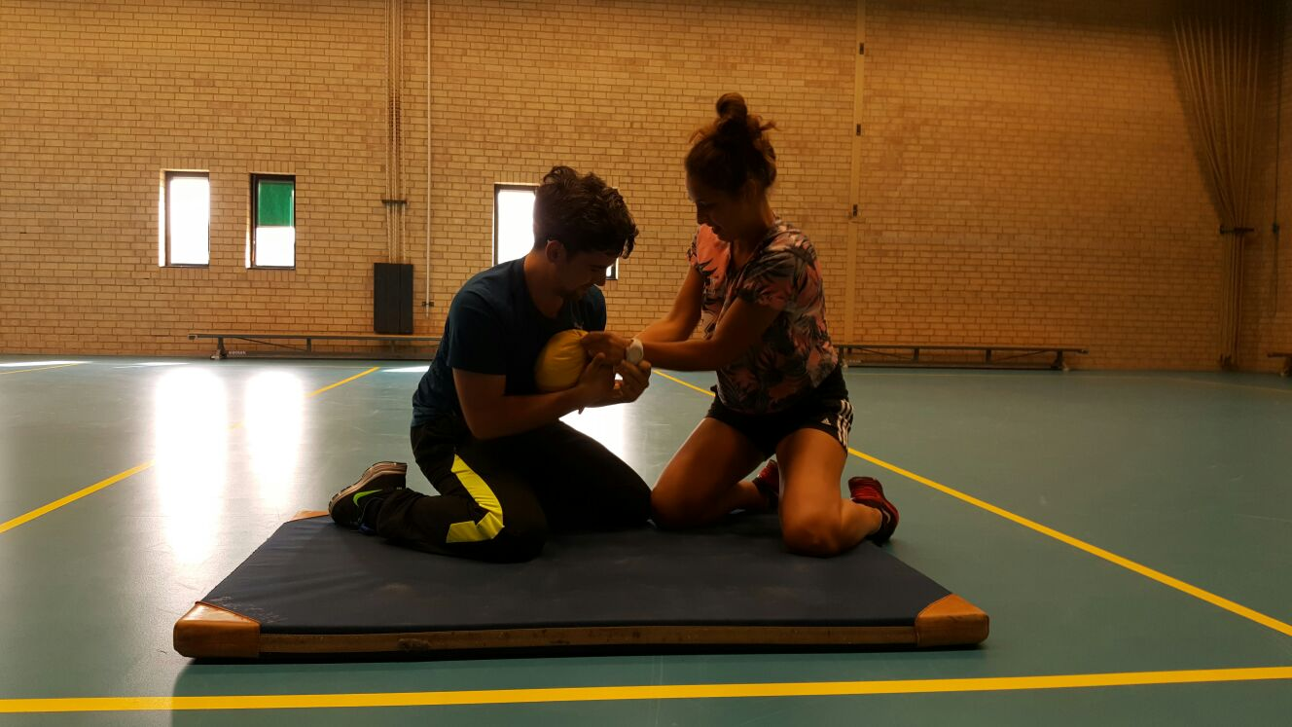
Thank you for the amazing week!

Slide 15
Our games with connection, power/strength, balancing, grounding, attack and defender.
There are two persons on a mat. A is attacker and B defender. Try to take the socks out of the other person. First mat who has is winning.
Two people(A&B) on a mat and one ball. A is trying to steal the bal from B.
Two people, mat and a stick. Try to push eachother from the mat.
Chinese boxing. Two people are grounding and try to get the other person from their place with only to push and clap with your hands to the hands from the other person, or to take your hands away so the other person is out of balance.

