Slide 1
Psychomotoric therapy in a new way
Arianne Huijgen, Anke van der Straten, Jessie van Diessen and Sanne Brandsma

Slide 2
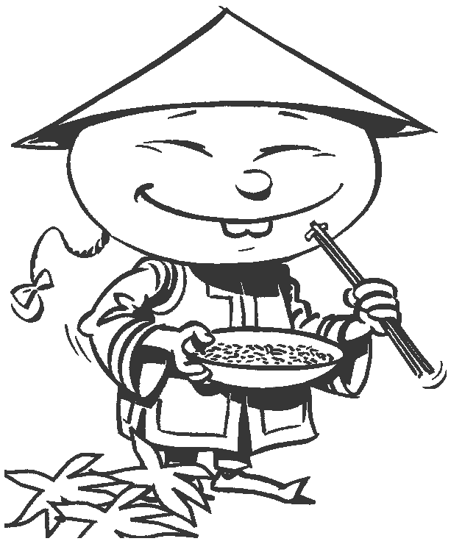
Chinese Boxing
Notes:
The whole group has to make couples. Every couple has to face eachother. The feeds hippwide and the distance between the couples is an armlength. They have to bring the arms up and clap eachother out of balance. The exercise takes 2 minutes. Afterwards we will discuss about what happened during the exercise and what we recognize from the whole week and what it means if we’re looking at the biopsychosocialmodel. (Motoric social sensibility, power, space, bodyawareness)

Slide 3
Bio psycho social model
Group dynamics
Bio Psycho Social
Notes:
We use the word group dynamics because we think it’s an easy way to explain all the things we explored these week connected with the biopsychosocial model. The whole week was based on the biopsychosocial model and we tried to make our own twist about it so everyone will understand our look (from the Netherlands) at this model. We split the bio, psycho and social part en put the workshops in one of them.

Slide 4
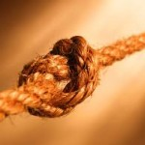
Group dynamics
Exercise: Untie the human knot
The interactions that influence the attitudes and behavior of people when they are grouped with others through either choice or accidental circumstances.
Notes:
Everybody will stand in a circle and close there eyes. There will be one of us in the middle talking the whole time so everyone knows where the middle is. Everybody will walk to the voice of the person in the middle with their hands in the air and a little bit forwards. They have to walk slowly until they meet another persons hand. Everyone has to hold an hand and when they are ready they can open their eyes. Now they have to untie the knot. They have 5 minutes to try. Afterwards we will discuss what happened in the group. Who takes the lead, where they speaking, how fast do they move, how was the contact and what was the atmosphere. With this exercise we tried to explain what group dynamics is and why we think it was very important this week. Space, body awareness, motoric social sensibility, trust.

Slide 5
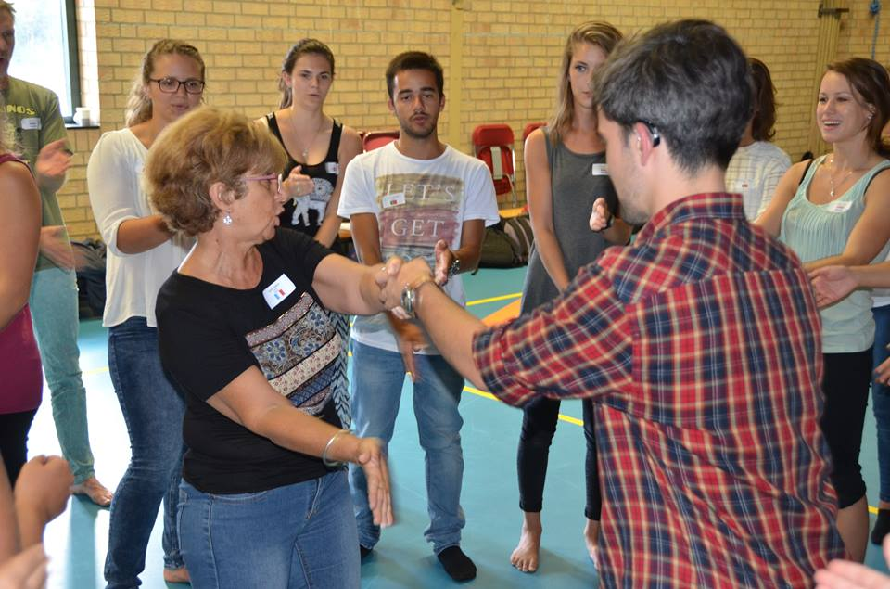
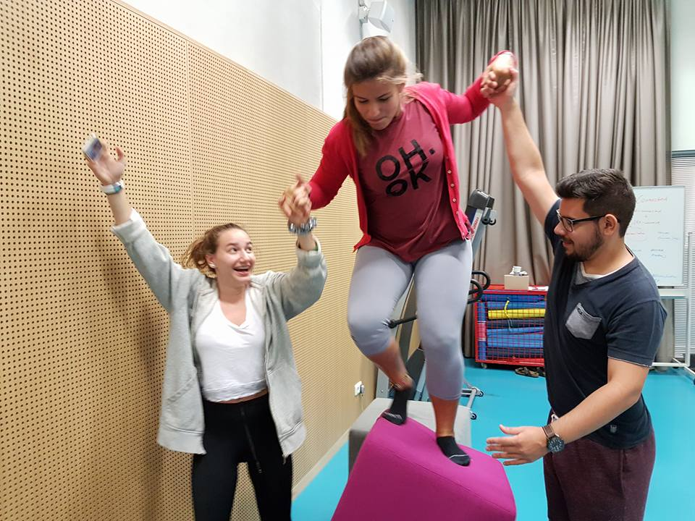
BIological
Genes, temperament and nutrition
The workshop from Fred and Sylvie:
The way of walking (the feeling)
The first reaction on stress
The way of breathing
What we learned about these workshops:
Exploring your body
Getting to know yourself emotionally and physically
→Exercise: 5-ball
Notes:
The group has to be splitted in 2 teams (5 by 5). One team has to wear ribbons so they know which team they are. The meaning of the game is to pull the ball to your own team for 5 times without being catched by the other team. By 5 they have one point and the other team must start. After the exercise we will discuss in the whole group what they feel in the body and what the biological part is in this game. (Winning-losing, the sensation in de body about stress/exitement/anger). Motoric social sensibility, power, space, trust, body awareness

Slide 6
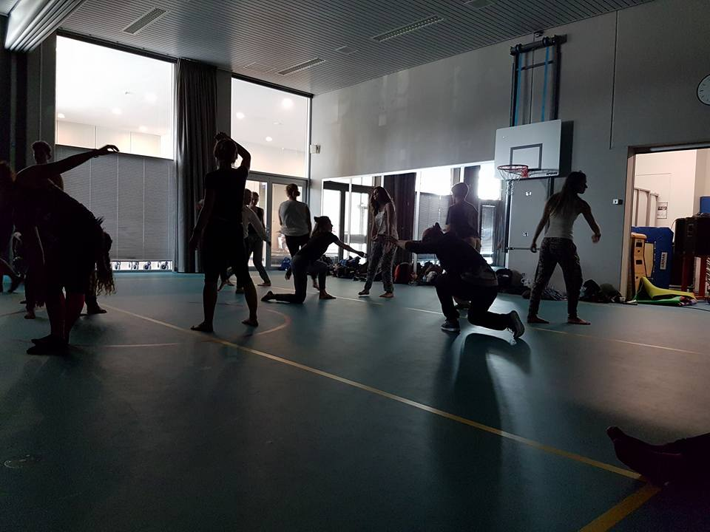
Psychological
Social skills, coping skills and self-esteem
The workshops from Dorte and Michèle:
Shame
Self exploration
Negative and positive thoughts
What we learned about these workshops:
First you have to be connected with yourself before you can connect with an other
Don’t judge and go with the flow
→ What do we think about the free movement and what was your experience?
Notes:
We really liked the free movement exercises and we wil use it in our therapys in the Netherlands we think. Like relationshiptherapy (dancing together and trust eachother without shame), therapy for people who has to experience the leader and follower roles (people who always lead has to learn how to follow and the other way).

Slide 7
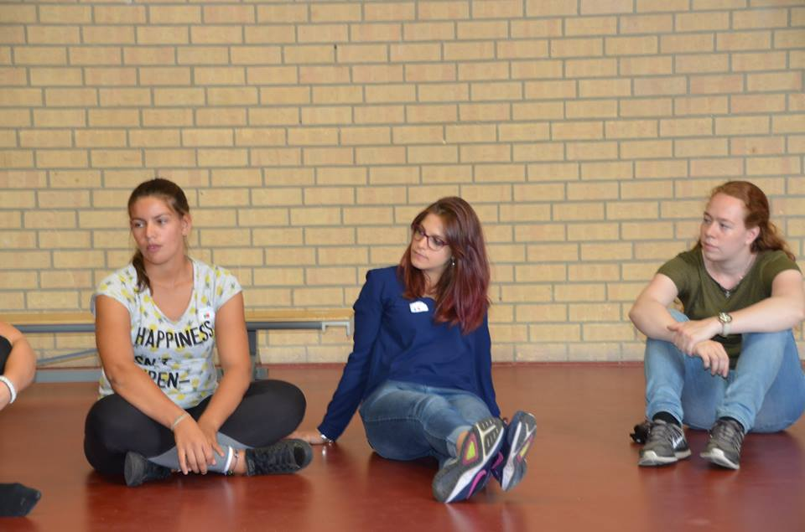
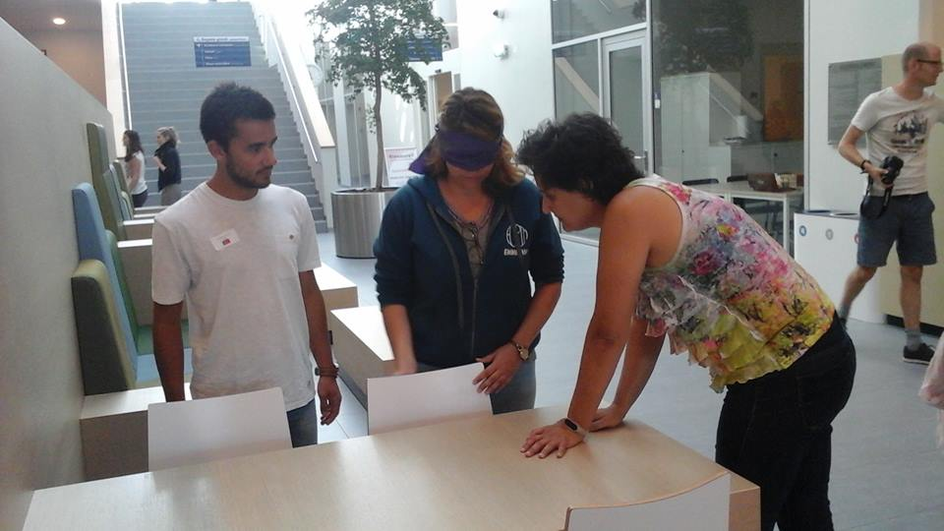
Social
School, environment and family
The workshop from Cristina and Olivier:
Contact in different ways
Leading and following
Physical
What we learned about these workshops:
You have to build a relationship before you can work with the cliënt (trust)
Try to connect in different ways like physical, emotional and cognitive
→Exercise: Making statues
Notes:
The group has to split in two different groups, in this case that means 2 groups of 6. One of the ‘teachers’ will give the groups an exercise, and then the group has to make a statue. For example, they have to make a statue with only 3 feet, 2 hands and one butt that touch the ground, the other body parts are not allowed on the ground. Space, motoric social sensibility, relaxation, power, body awareness.

Slide 8
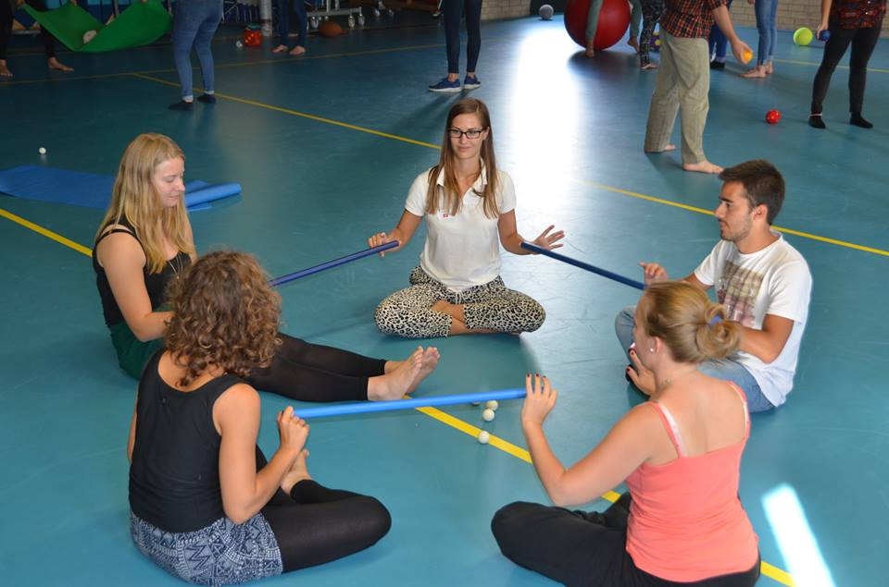
Conclusion
What did we learn this whole week:
How to make contact with yourself, the other and de world
You have to be connected with yourself before you can be connected with the other. If you connect with the other without being connected with yourself, it’s possible you get sick.
We think this is one of the most important things in our job!

Slide 9
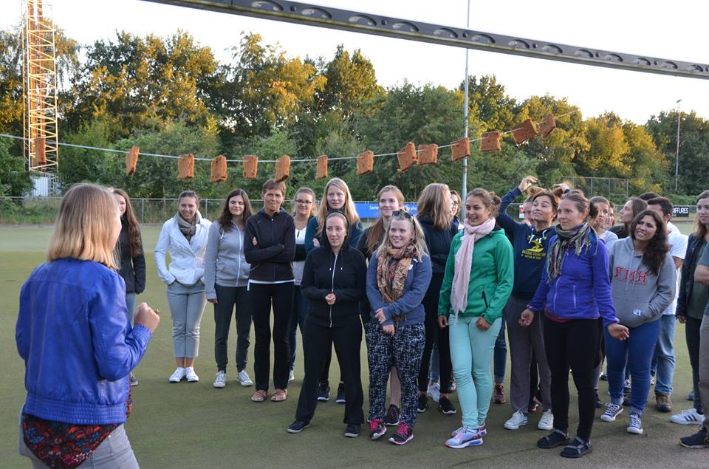
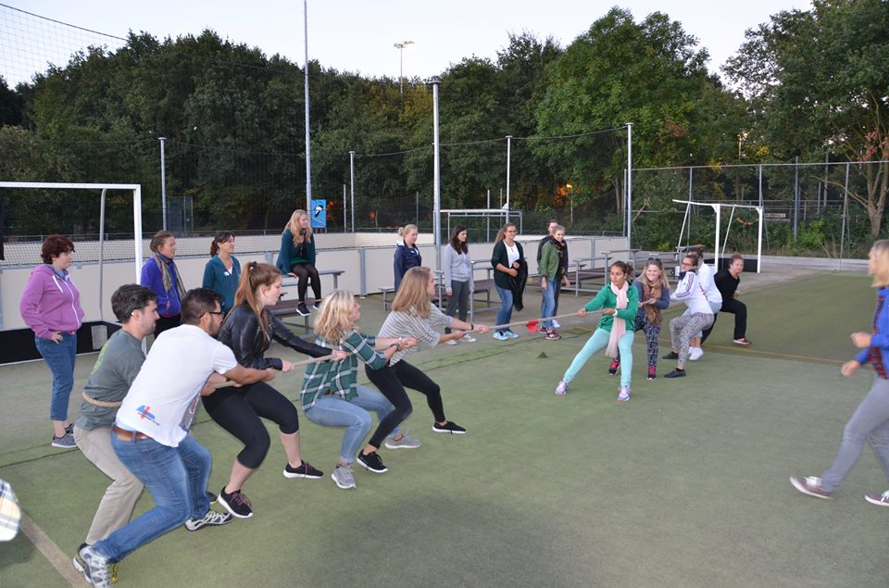
Conclusion
What did we learn this whole week:
If you look at all the different cultures, languages and view of PMT it’s special we became one group! We think it’s because of the group dynamics.
We think this is an very important thing in our country and that’s why we used it in our presentation.

Slide 10
References
Blink, Martin van den; Dijk, Fred;. (2016). 7 psychomotorische thema´s. Deventer: DaM uitgeverij.
Geluk, H. (2009). Groepsdynamica, theorie en vaardigheden. Amsterdam: Pearson Education.
Nieuwenhuis, M. (2010). Leiderschap en teamontwikkeling. Opgehaald van The Art of Management: http://123management.nl/0/030_cultuur/a300_cultuur_11a_teamontwikkeling_tuckman.html
Over het bio-psycho-sociale model. (sd). Opgehaald van Fonds Psychische Gezondheid: http://www.psychischegezondheid.nl/page/204/bio-psycho-sociale-model.html

