Slide 1

Vision & Alliance
Cristina Espadinha – cespadinha@fmh.ulisboa.pt

Slide 2

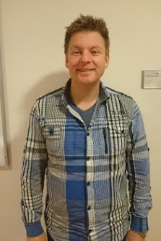
Hi!

Slide 3
Vision: Eye

Slide 4
Vision: Eye in motion

Slide 5
Problems in Vision

Slide 6
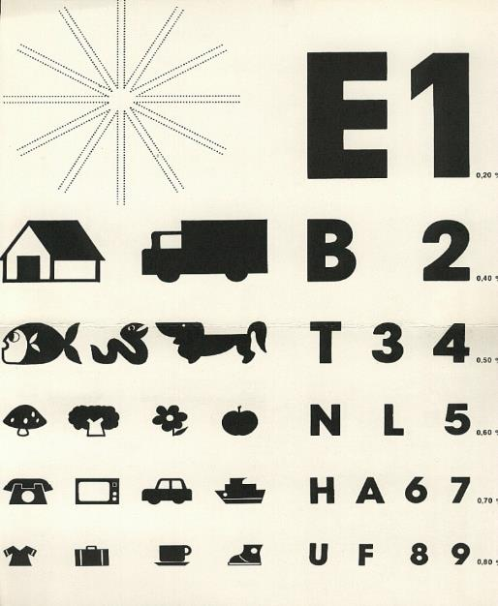
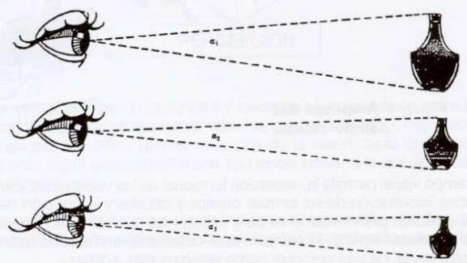
Problems in Vision
Acuity
The ability to distinguish a specific visual object from other similar stimuli

Slide 7
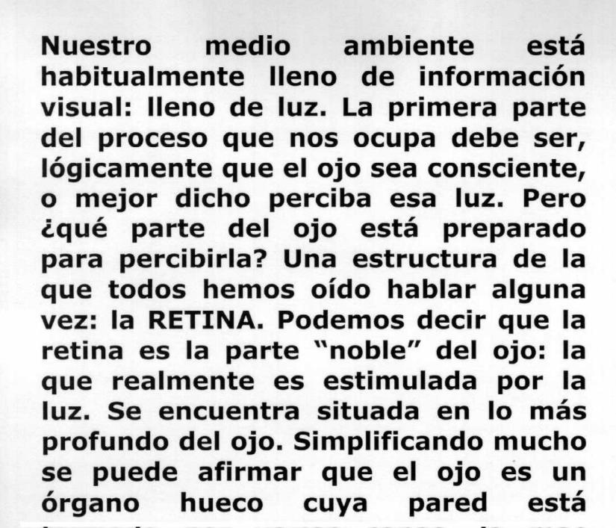
Problems in Vision: Acuity

Slide 8
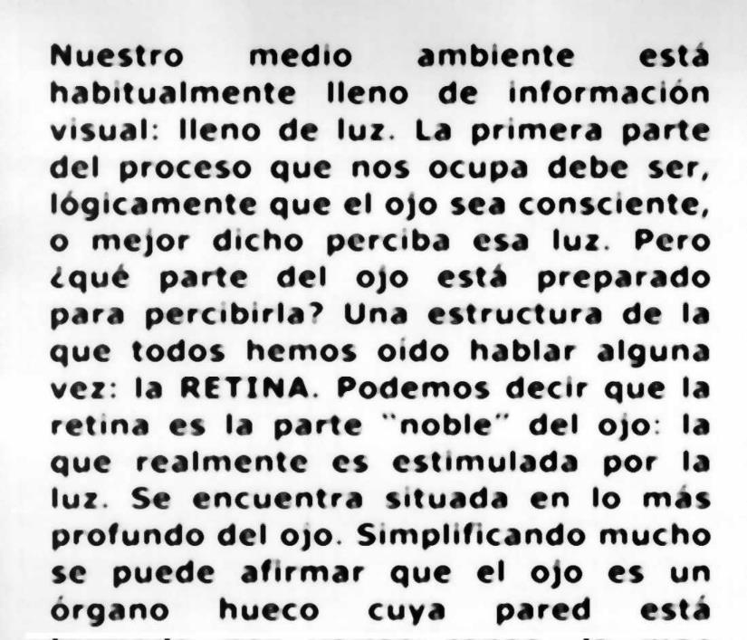
Problems in Vision: Acuity

Slide 9
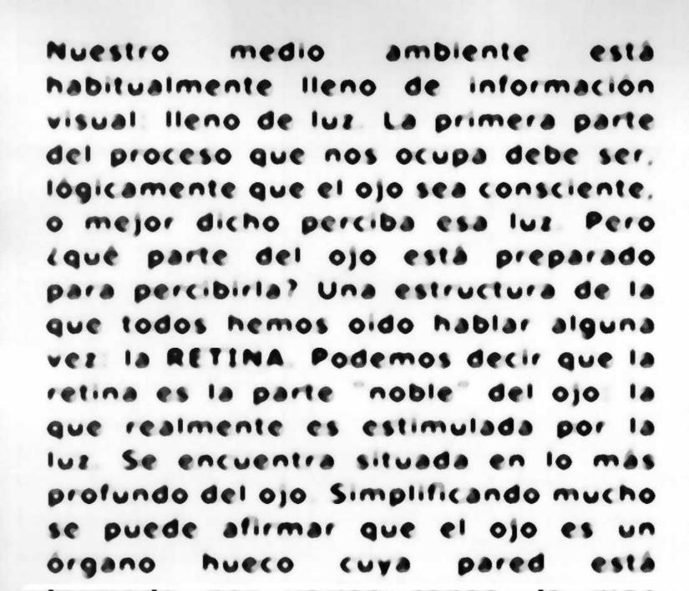
Problems in Vision: Acuity

Slide 10
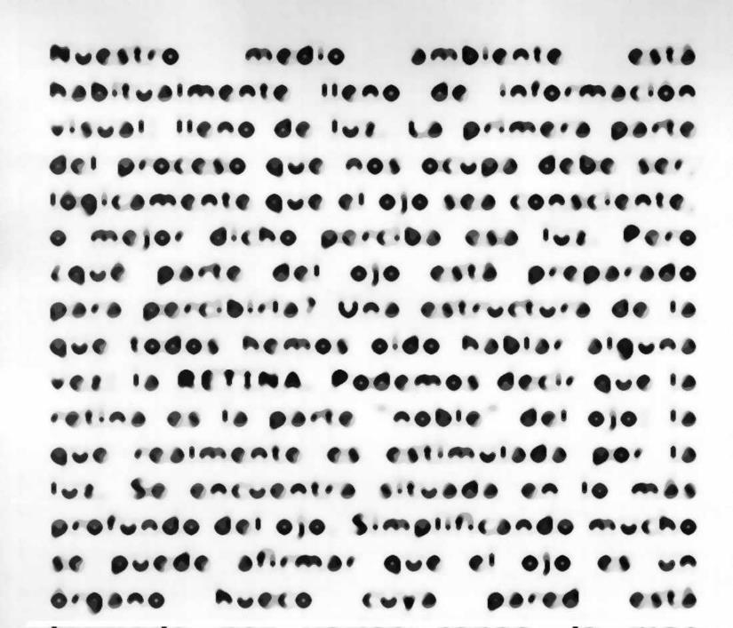
Problems in Vision: Acuity

Slide 11
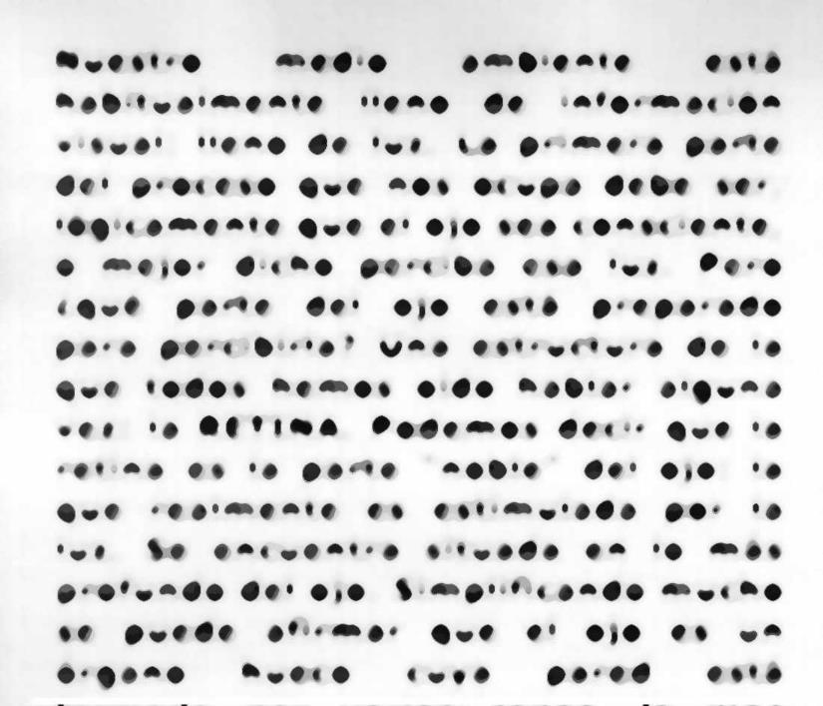
Problems in Vision: Acuity

Slide 12
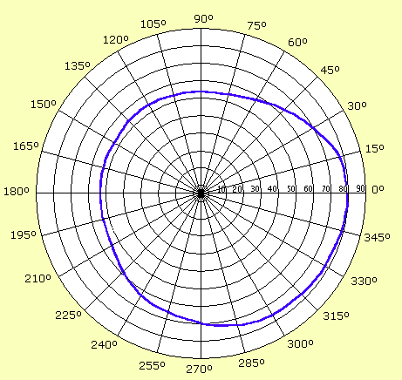
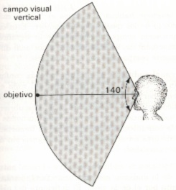
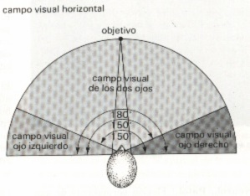
Problems in Vision
Visual Field

Slide 13
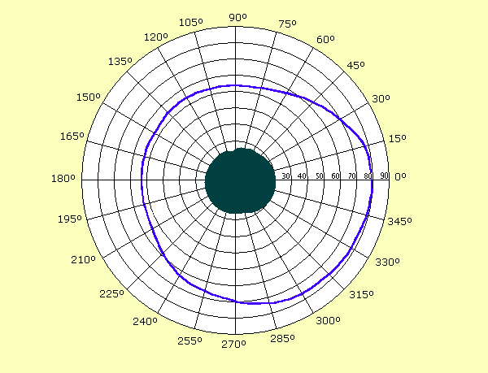
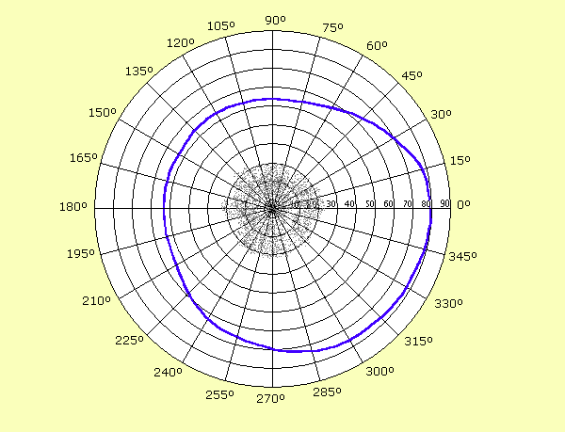
Problems in Vision
Visual Field
Absolute scotomata
Relative scotomata

Slide 14
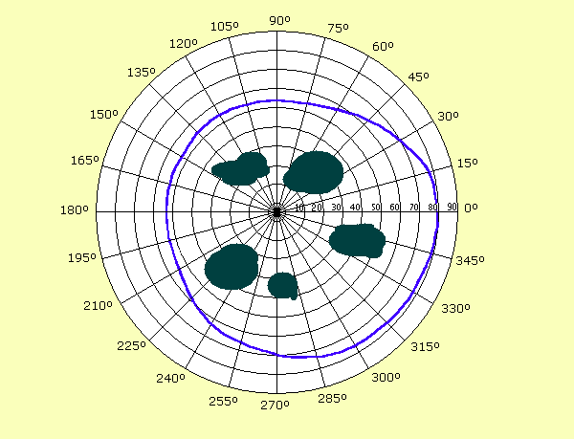
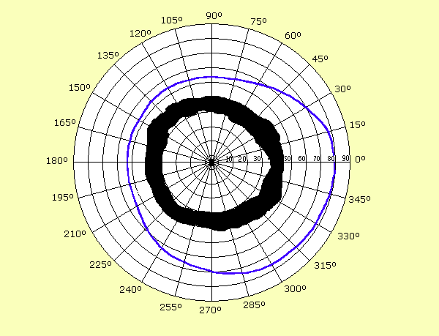
Problems in Vision
Visual Field
Multiple scotomata
Tubular field

Slide 15
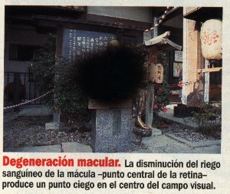
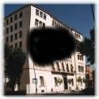
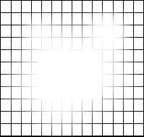
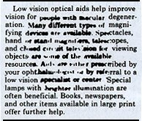
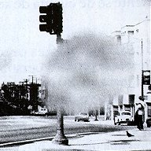

Problems in Vision
Scotomata in daily life

Slide 16
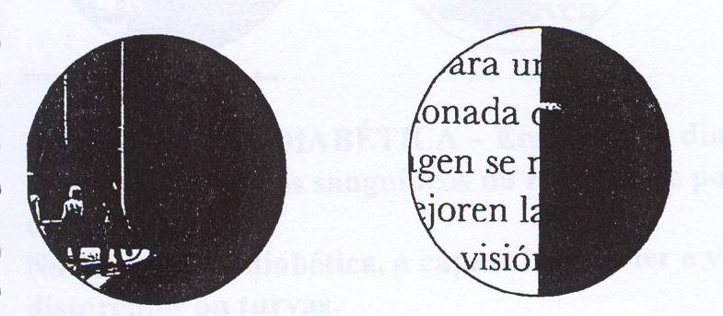
Problems in Vision
Scotomata in daily life

Slide 17
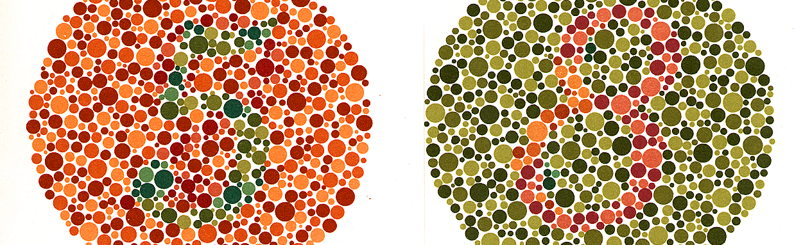
Problems in Vision
Colour vision

Slide 18
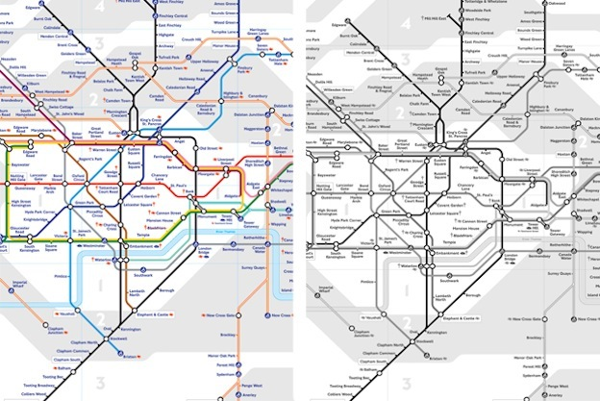
Problems in Vision
Colour vision

Slide 19
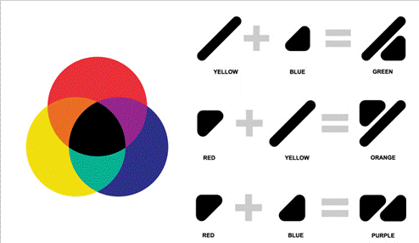

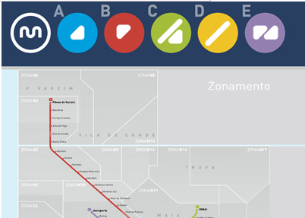
Problems in Vision
Colour vision

Slide 20

Problems in Vision
Contrast sensitivity –

Slide 21
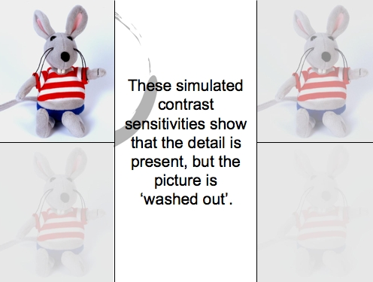
Problems in Vision
Contrast sensitivity –

Slide 22

Normal Vision

Slide 23
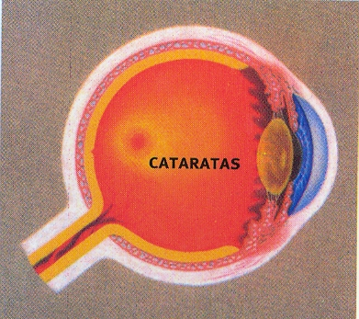
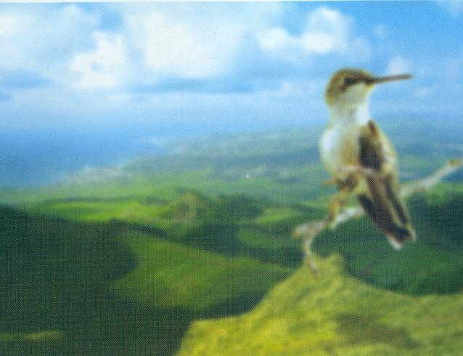
Cataracts
Problems in Vision

Slide 24

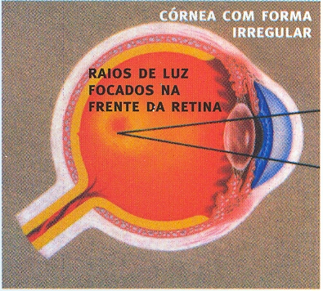
Myopia or near-sightedness
Problems in Vision
Notes:
The light from a distant object arriving at the eye lens may get converged at a point in front of the retina in the vitreous body.

Slide 25
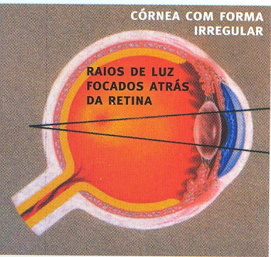

Hypermetropia or farsightedness
Problems in Vision
Notes:
If the eye-lens focuses the incoming light at a point behind the retina

Slide 26
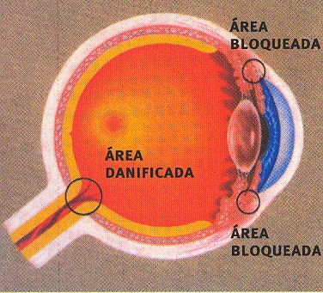

Glaucoma
Problems in Vision
Notes:
Glaucoma is a group of eye diseases causing optic nerve damage. The optic nerve carries images from the retina, which is the specialized light sensing tissue, to the brain so we can see. In glaucoma, eye pressure plays a role in damaging the delicate nerve fibers of the optic nerve. When a significant number of nerve fibers are damaged, blind spots develop in the field of vision. Once nerve damage and visual loss occur, it is permanent. Most people don't notice these blind areas until much of the optic nerve damage has already occurred. If the entire nerve is destroyed, blindness results. Glaucoma is a leading cause of blindness in the world, especially in older people.

Slide 27
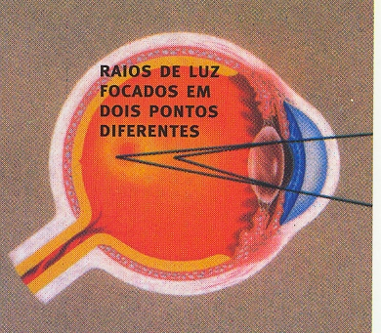

Astigmatism
Problems in Vision
Notes:
Astigmatism – objects are focus in two different retina spots – blurry vision.

Slide 28

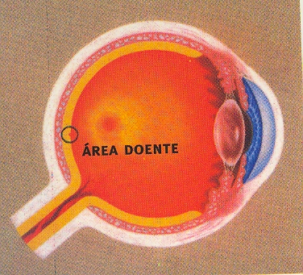
Macular Degeneration
Problems in Vision
Notes:
Loss of vision in the macula spot, where is the central vision placed.

Slide 29

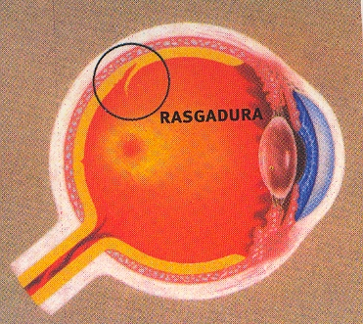
Torn Retina
Problems in Vision

Slide 30

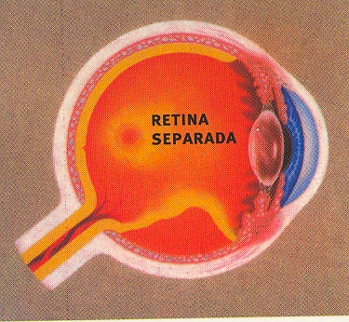
Retinal Detachment
Problems in Vision

Slide 31
Signs – Alerts of vision problems
1 – Changes in the eyes and in the Face:
red and inclined eyelids;
red or bloodshot eyes;
frequent tearing eyes;
frequent infections;
frowning and grimacing;
bend or blink the eyes frequently;
…

Slide 32
Signs – Alerts of vision problems
2 – Complains:
seeing blurry objects or double vision;
pain, itching or stinging in the eyes;
headache, nausea and dizziness;
difficulties in identifying objects at certain distances;
difficulties to use vision in different types of lighting - very sensitive to light and glare;
...

Slide 33
Signs – Alerts of vision problems
3 – Psychomotor Behavior
rubbing the eyes;
getting objects too close of the eyes or one eye;
walking tense or awkward, go against objects in unfamiliar places;
tilting the head always to the same position;
follow moving objects by rotating the head instead of eyes
...

Slide 34
Signs – Alerts of vision problems
4 – Social-Emotional Behavior
gets annoyed when needs to do reading or writing assignments;
get tired easily in tasks requiring near vision;
has trouble keeping attention to classroom activities;
avoids participating in physical activities;
asks the teacher to get information about what is happening;
...

Slide 35
Education example from a Portuguese
Mainstream school
(with additional resources for the visual impaired students)

Slide 36
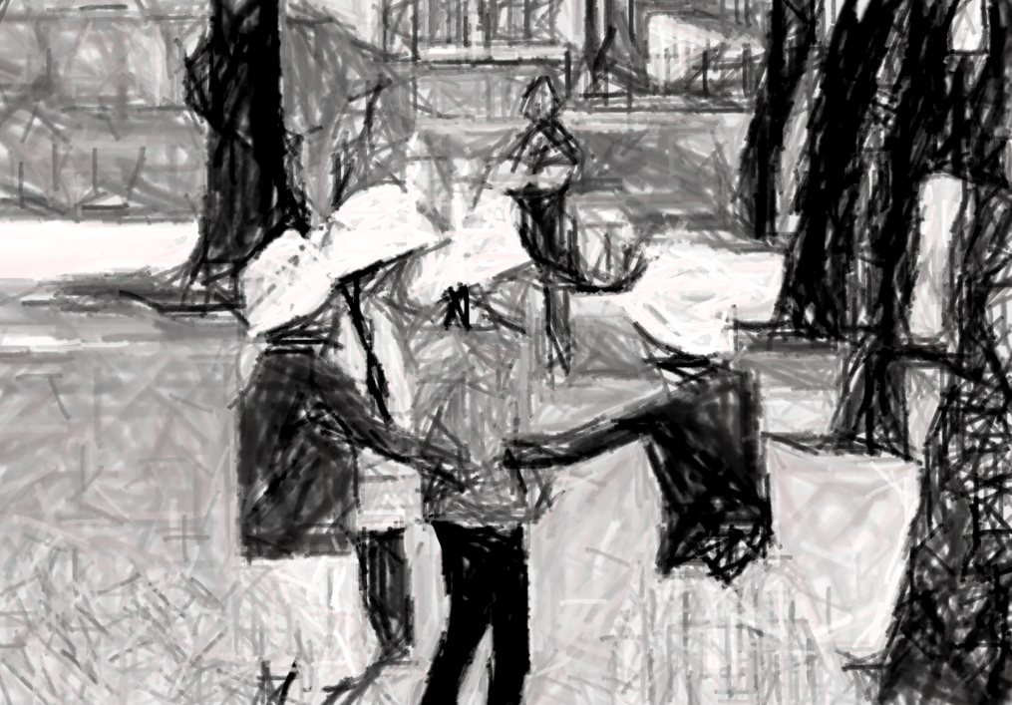
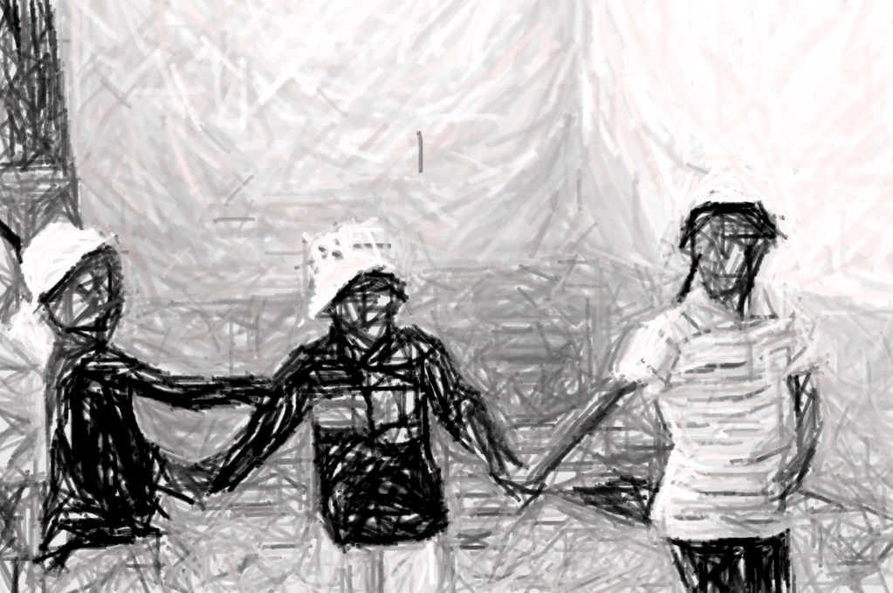
Social Activities

Slide 37
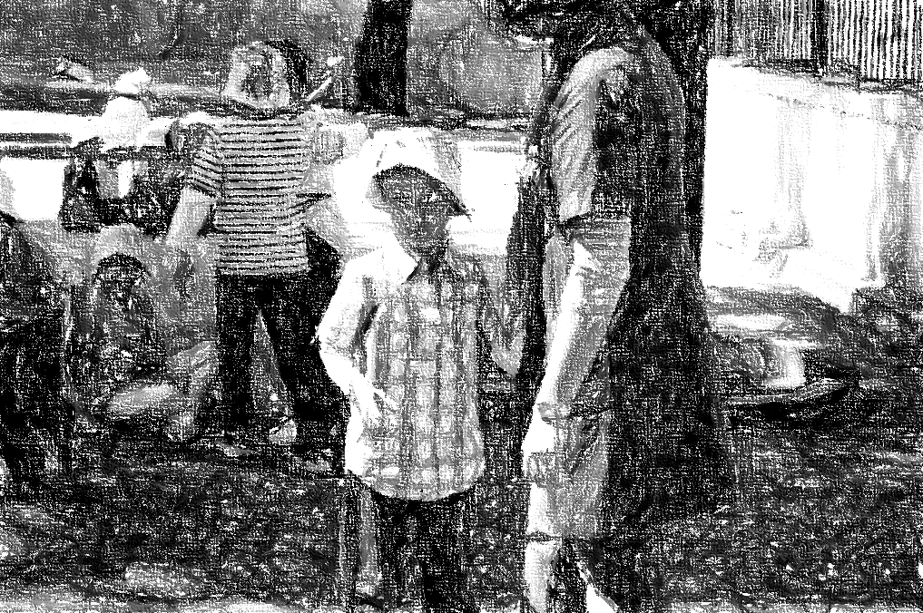
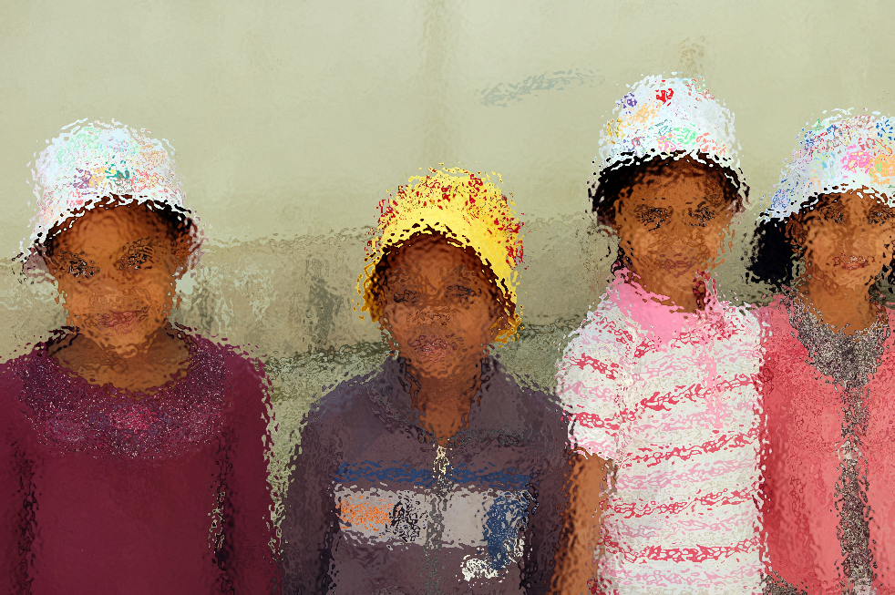
Social Activities

Slide 38
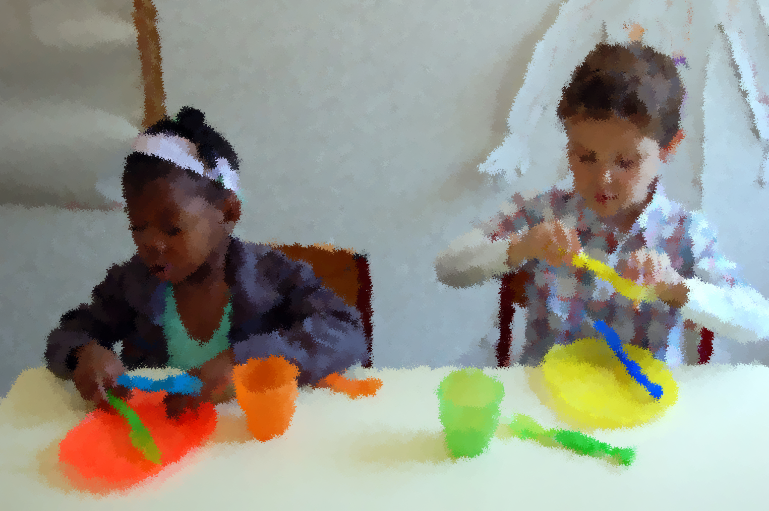
Daily Living Activities… learning by play

Slide 39

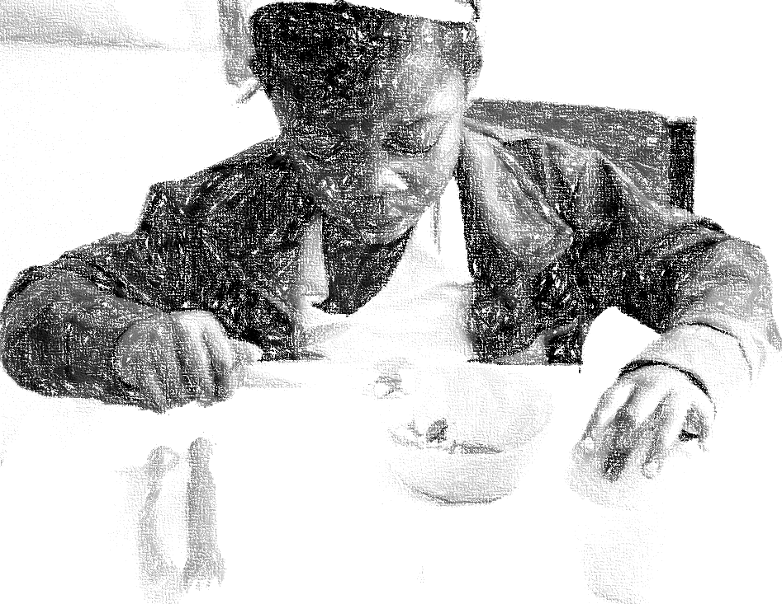
Daily Living Activities… learning by play

Slide 40
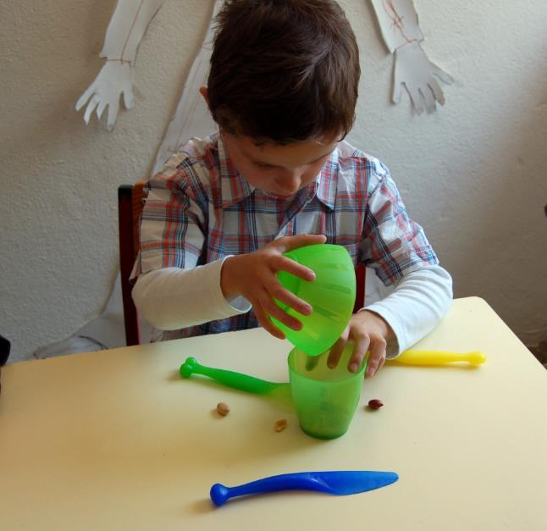
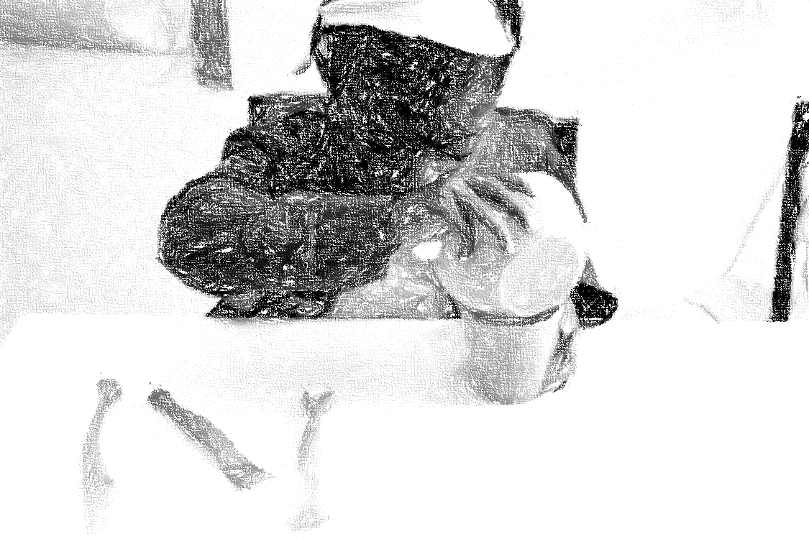
Daily Living Activities… learning by play

Slide 41
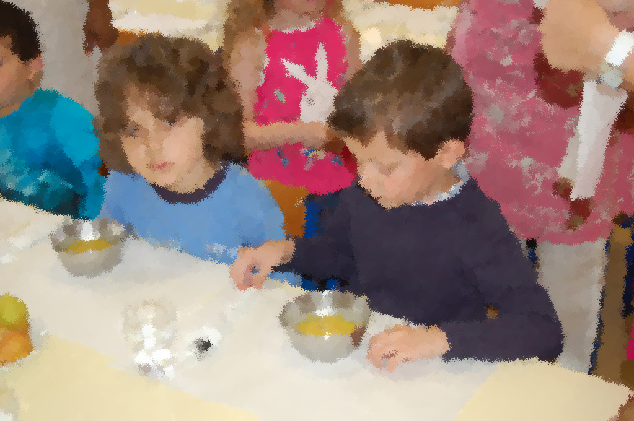
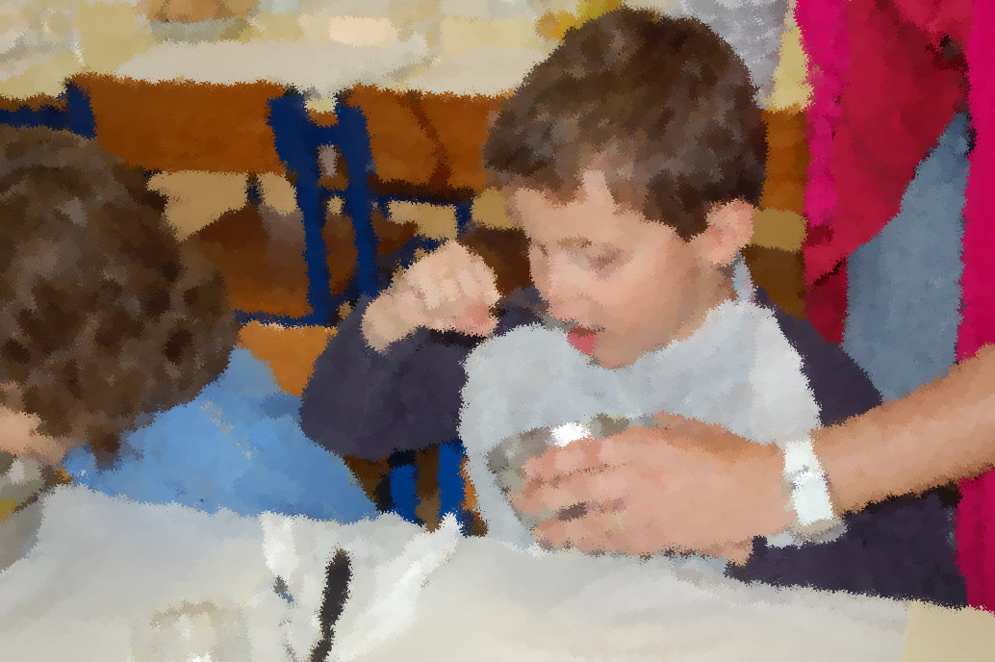
Daily Living Activities… In Context
Autonomia na refeição

Slide 42
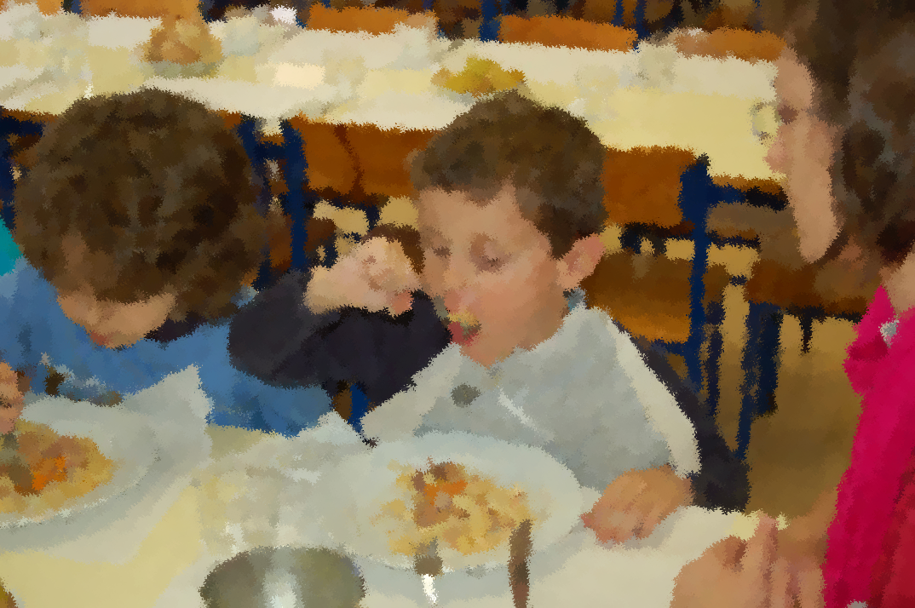
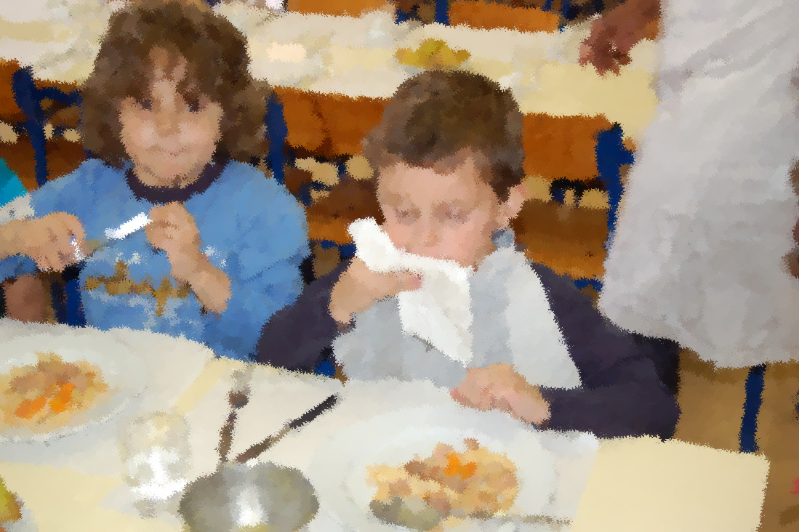
Daily Living Activities… In Context

Slide 43
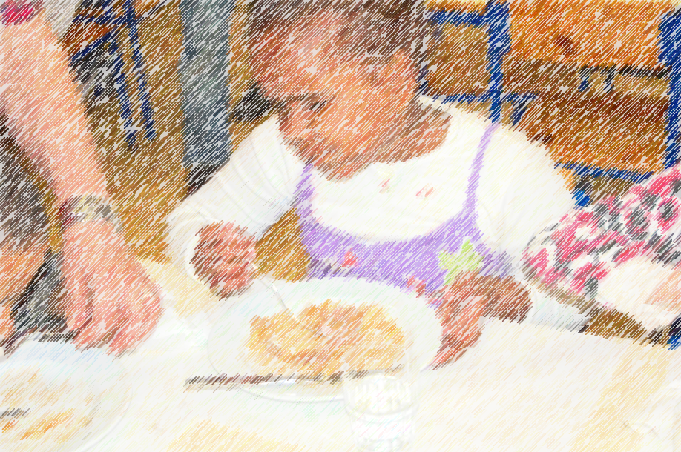
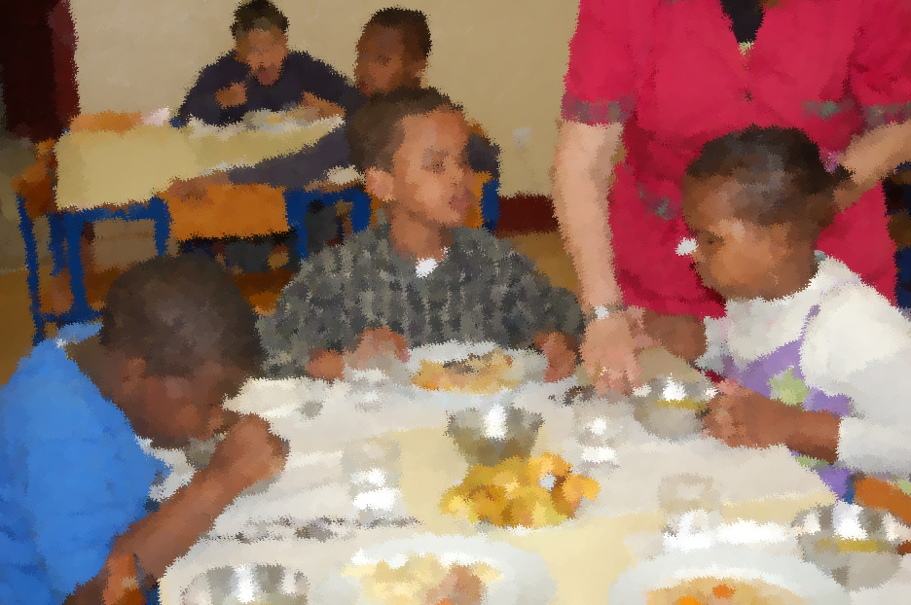
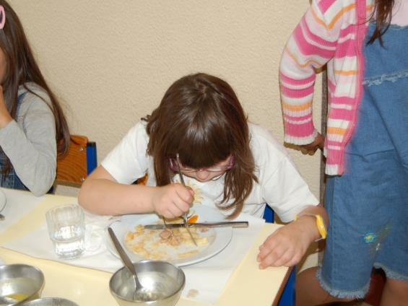
Daily Living Activities… In Context
Autonomia na refeição

Slide 44


Daily Living Activities… In Context

Slide 45


Before Reading… know the world

Slide 46


Before Reading… know the world

Slide 47


Before Reading… know the world
Field trips…

Slide 48


Field trips…

Slide 49


Field Trips…

Slide 50



Learning ….. Hands on!
Around…
Up…
In…

Slide 51



Learning ….. Hands on!
Comparing sizes - Thickness

Slide 52


Learning ….. Hands on!
Comparing sizes - High

Slide 53



Learning ….. Hands on!
Limit/Border:
In-Out

Slide 54

Orientation & Mobility

Slide 55


Learning ….. Hands on!

Slide 56


Before Reading… learning concepts
Finger Stimulus:
Equal-Different

Slide 57


Before Reading… learning concepts
Directions: Left-Right. / Top-Down
Vertical, Horizontal, Perpendicular
Placing the hands

Slide 58


Before Reading… learning concepts
Finger Stimulus:
Equal-Different

Slide 59




Before Reading… learning concepts
Series
Spatial
Notions
Strait
Lines

Slide 60




Before Reading… learning concepts
Curve Lines
Sizes

Slide 61

Before Reading… learning concepts
Brincar com o braille
Noções espaciais

Slide 62


Before Reading… playing with braille

Slide 63


Before Reading… playing with braille

Slide 64


Before Writing… playing with braille

Slide 65


Reading…

Slide 66


Writing…
Ditado
Cópia

Slide 67


Low Vision…
… other way of seeing

Slide 68

Low Vision…
… other way of seeing

Slide 69


Low Vision…
… other way of seeing

Slide 70


Low Vision…
… other way of seeing

Slide 71


Learning…
… with the eyes and touch

Slide 72

Learning…
… with the eyes and touch

Slide 73

In the classroom

Slide 74

In the classroom

Slide 75



In the classroom

Slide 76


Mastering the ICT

Slide 77

Step-by-Step:
The Sighted Guide Technique
This video series provides information on how to use the “sighted guide technique” to guide someone with vision loss while working, as well as how to offer assistance in various situations.
Use the link to see the videos
http://www.cnib.ca/en/living/how-to-videos/Pages/The-Sighted-Guide-Technique.aspx
Or:
https://www.youtube.com/playlist?list=PLpAOW00xNyybYZ7EmTk3nSvSNoPGK3r7E
And download the booklet here:
http://www.cnib.ca/en/about/Publications/vision-health/Documents/CNIB_STEP_BY_STEP_2012_ENG%20FINAL-s.pdf

